Slide 1
Complications of Pterygium Surgery
Ouk Sok Hean^{1*}, Do Seiha^{2*}, Sok Kheng^{3*}, Ly Marina^{4*}, Krin Srey Peou^{5*}

Slide 2
Introduction
Pterygium surgery is quite common in Cambodia, which is situated within the tropics. Simple excision carries a high recurrence rate ranging from 24%–89%³, hence, this study aimed to determine the outcome of conjunctival autograft in primary pterygium.

Slide 3
Objective
To investigate the efficiency of limbal conjunctival autograft in primary pterygium. To report the incidence of recurrence and complications after primary pterygium surgery, using limbal conjunctival autograft.

Slide 4
Methods
It is a retrospective study conducted at Khmer-Soviet Friendship Hospital/Do Seiha Eye Clinic in Phnom Penh, Cambodia for a period of 16 months (Jan 2013 to April 2014).
A total of 55 patients were operated during the studied period, 39 of which completed the follow up criteria.

Slide 5
Methods
All patients underwent the same technique – pterygium excision with conjunctival autograft – with experienced ophthalmologist Dr. Do Seiha.
Graft was sutured in place using 10-0 nylon and stitches were removed 10 days post-operatively.
Follow up was set to be first day, 10 days, 1 months and every 3 months for the first year and then yearly. All patients were in age group 20 to 60 and above.

Slide 6
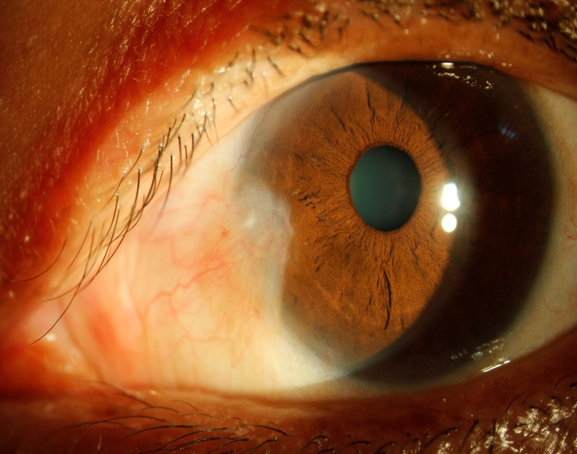
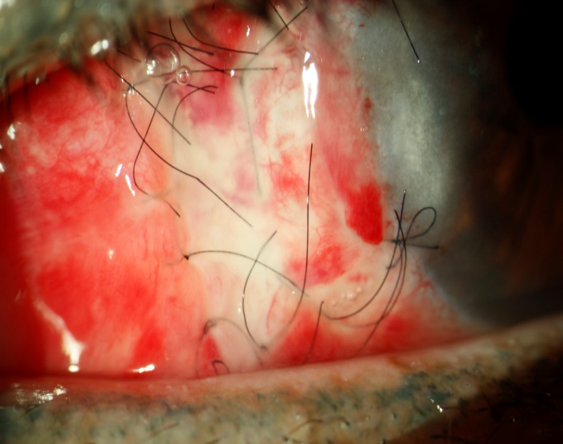
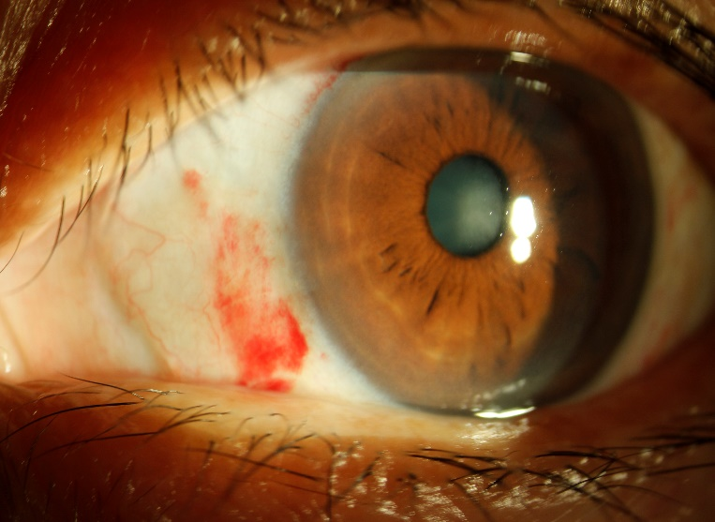
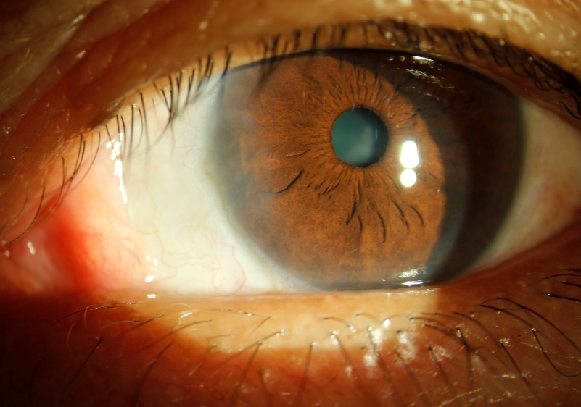
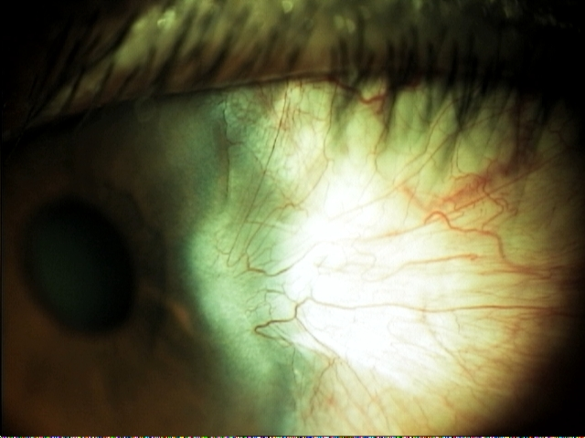

Slide 7
Results
In this study, 23% were found in the age group of 20-40.
About 54%, and 23% belong to the age group of 40-60 and above 60, respectively.
Pterygium is more often seen in female than male, accounting for 59% and 41%, respectively.
Depending on location, 92% (36 cases) has pterygium nasally. Temporal and kissing pterygium accounted for 5% and 3% respectively.

Slide 8
Resutls
The recurrent rate was 8% (3 cases).
2 cases had granuloma
2 cases had increased intraocular pressure due to steroid after 3 weeks post-operation.
Though, theses cases were managed successfully. No major sight-threatening complications occurred during the study period.

Slide 10
Conclusion
Autogenous conjunctival grafting is a safe, uncomplicated, and quick procedure and does not involve loss of tissue and prevents recurrence of pterygium. It also reduces the risk of scleral thinning and necrosis.

Slide 12
